Slide 1

November General Family Support Group
November 18, 2020
Self-Care for the Caregiver of an
Autistic Family Member
(Discussing Compassion Fatigue and the 5 Love Languages)
Stacy Hurley, LCSW-C, Howard County Autism Society, Family Navigator

Slide 2
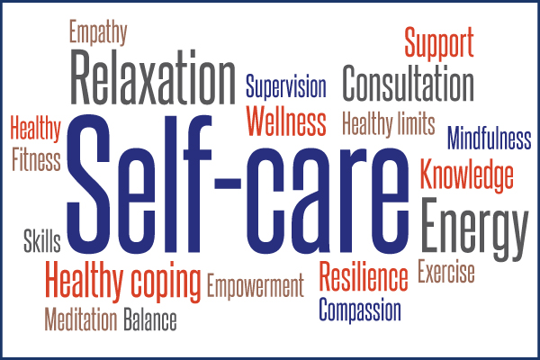

Slide 3
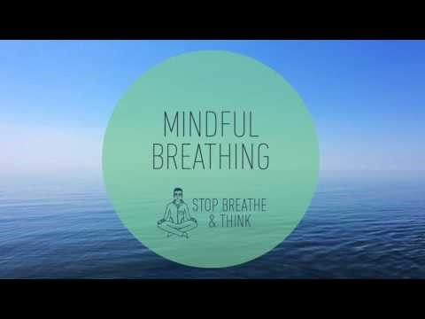
Let’s Meditate for a moment
https://www.youtube.com/watch?v=SEfs5TJZ6Nk

Slide 4
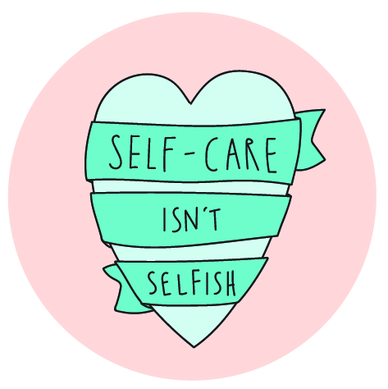
Order of topics
Introduction
Identifying stressful triggers
Self-care considerations
Compassion Fatigue
What is your Love Language?
Takeaways
Questions & Feedback
Check out the Resources!

Slide 5
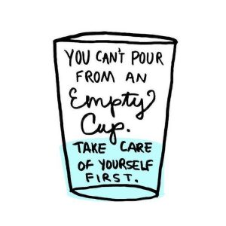
What are your stressors?
Notes:
Self-care is not selfish. You must fill your own cup before you can pour into others.

Slide 6
Identifying stressful triggers
Work | Childcare | Legal matters
Finances | Relationships | Mental health
Physical health | Schedule | Amount of free time
Trauma | Food Security | Spiritual/Religious issues
Helping with child’s schooling | Attitudes/thoughts | Career decisions
Health of family | Housing | Life changes
What else?!
Notes:
"When parents are feeling stressed about math or reading, it’s helpful to remind yourself that even during a pandemic, children are learning many new things they’ve never faced before and that’s important."
Melissa Cousino, Ph.D.

Slide 7
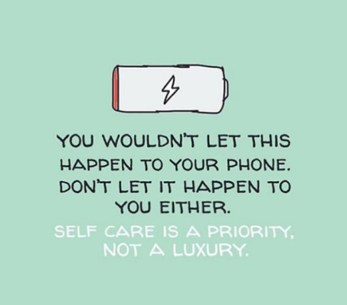
What does self-care mean to you?
How do you go about doing it?
Notes:
self-care and mental health
Ideally, we all engage in regular self-care in which we do the things that make us feel taken care of mentally, physically, and emotionally. But this doesn’t always happen, and we may need to stop and take the time to remind ourselves we are important, too.
Sometimes our feelings become too much and we need to distract ourselves until we are better able to cope. We can also strategically change how we are feeling when things become too overwhelming.

Slide 8
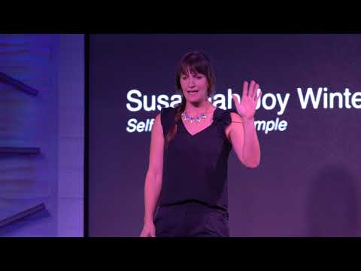
So what is self-care?
Self-care is important to maintaining a healthy relationship with yourself. It means doing things to take care of our minds, bodies, and souls by engaging in activities that promote well-being and reduce stress. Doing so enhances our ability to live fully, vibrantly, and effectively. The practice of self-care also reminds both you and others that your needs are valid and a priority.

Slide 9
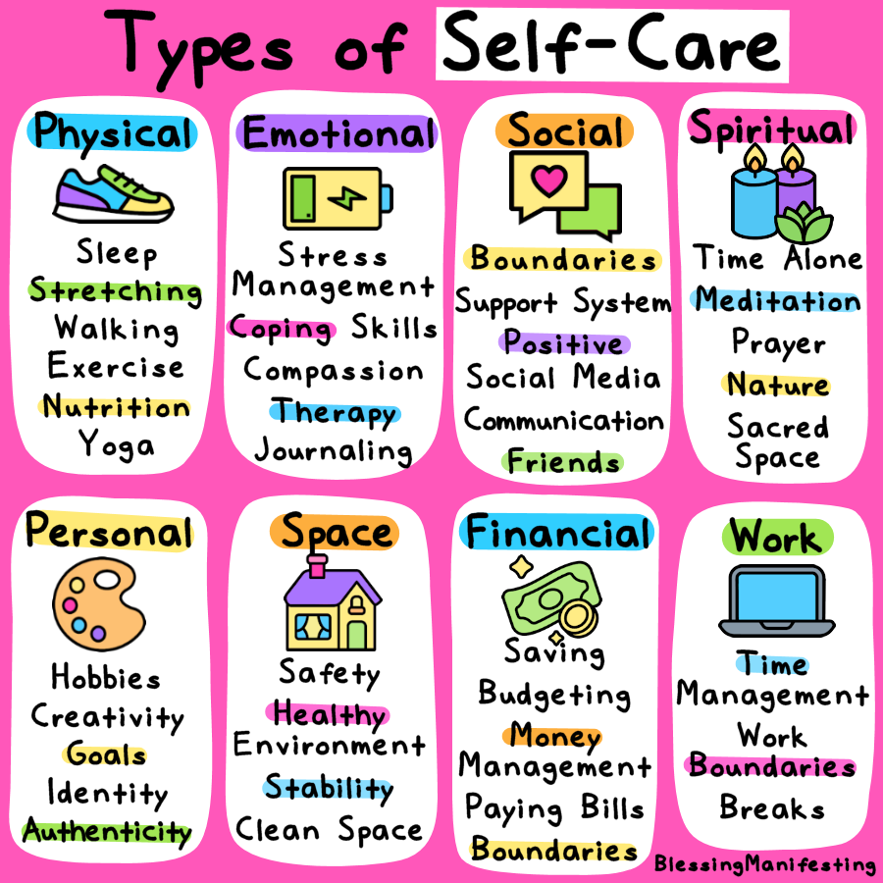
So How do I practice self-care?
Focus on the positive.
Acknowledge what you have accomplished.
Continue family rituals.
Give yourself time to adjust.
Make time for your friends.
Explore creative interests outside of autism.
Get involved with the autism community!
Respite Care
*Adapted from Autismspeaks.org
Notes:
Even if it is just for 15 minutes a day, take a breather. You need to take care of yourself in order to be able to take care of others. Take time to yourself so you can run errands, relax or enjoy time with your partner or other family members.

Slide 10
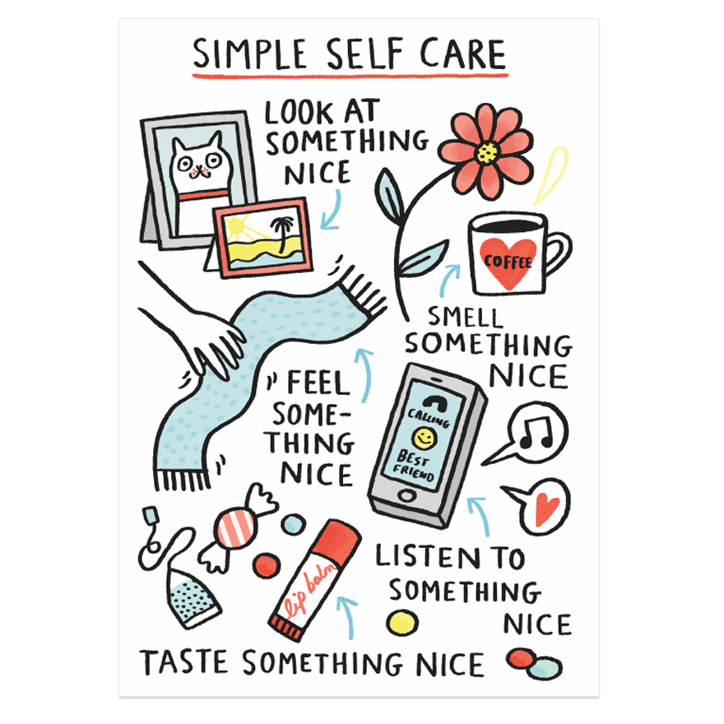
Examples of self-care
Clean
Cook or bake
Cross something off your
to-do list
Exercise
Get a massage
Go for a walk
Listen to music or a podcast
Make art
Meditation
Mindfulness exercises
Play a game
Practice deep breathing
Read
Take a bath
Take a (timed) nap
Watch TV or a movie
Yoga

Slide 11

Distraction as a strategy
WHY SHOULD I DISTRACT MYSELF?
Activities are a great way for us to distract ourselves from our current emotions until we are better able to cope. When our level of distress is too high, we may not be able to effectively handle a situation and need ways to bring our emotional state down. Some suggestions may seem similar to self-care, but distraction activities serve a different purpose. One person’s self-care activity is another’s distraction technique.

Slide 12
EXAMPLES OF DISTRACTION ACTIVITIES
Call a friend (and don’t talk about what’s causing you distress)
Create something
Describe your surroundings using your five senses
Do a puzzle
Do something kind for someone else
Focus on a single task
Go out to eat
Go to an event
Hold ice
Listen to music or a podcast
Make a list of things (cars, dog breeds, music artists, etc.)
Take a hot or cold shower
Try something new
Volunteer
Watch something funny
Watch TV or a movie
Notes:
changing our emotions
IS MY RESPONSE WARRANTED?
Check to see if the situation warrants the response you’re having. Examine the facts. While our emotions are always valid, they are not always justified. Look to see if your emotional response matches the circumstances.
AM I BEING EFFECTIVE?
Examine whether what you’re doing is helping or hurting the situation. If it’s making things worse, do the opposite of whatever it is you feel like doing. Commit to it. If you want to stay home and isolate, force yourself to go out where there are people. If you’re angry and want to yell, try avoiding the person who your anger is directed towards.

Slide 13
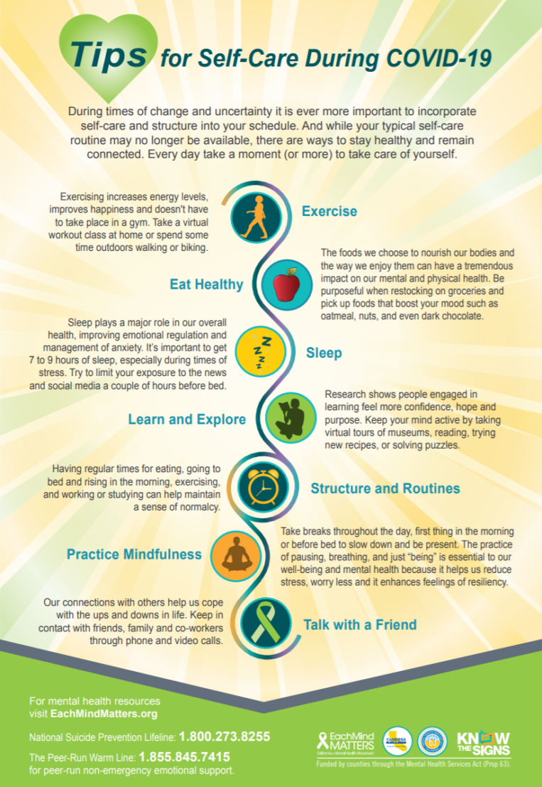
self-care recommendations
FROM CALIFORNIA’S EACH MIND MATTERS
Exercise
Eat Healthy
Sleep
Learn and Explore
Structure and Routines
Practice Mindfulness
Talk with a Friend

Slide 14

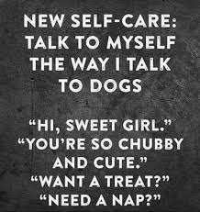
Do you have a self care plan?
Do you follow it?

Slide 15
Develop your self-care plan
For each category in your self care plan, select at least one strategy or activity that you can undertake. You might notice areas of overlap between these categories. It is important to develop a self-care plan that is holistic and individual to you.
Use a self-care plan template or create your own.
Fill your self-care plan with activities that you enjoy and that support your wellbeing.
Keep this in a place where you can see it every day. Keeping it visible will help you to think about and commit to the strategies in your plan. You can also share it with your friends and family so they can support you in your actions.
Stick to your plan and practice the activities regularly. Just like an athlete doesn’t become fit by merely ‘thinking’ about fitness, as a parent/caregiver you can’t expect to perform effectively without putting into practice a holistic plan for your wellbeing.
Re-assess how you are going at the end of one month and then three months. Plans can take over a month to become habits, so check-in and be realistic about your own self-care plan. After a while, come back and complete the self-care assessment again to find out how you are going with your new habits.
Developing a self-care plan | Teacher wellbeing
Notes:
So you say, Stacy and Brad, this all sounds great and yeah I am stressed, but what am I supposed to do when my kids are home and I have not one to help? How can I actually make these things happen?
Planning for self-care
Many people find that developing a personalised self-care plan provides a solid foundation for effective self-care. Others report that the proactive nature of consciously planning for self-care is also in itself effective, without necessarily documenting a formal plan. Whichever option you prefer, personalised planning for self-care can be a tremendous support for putting the theory of self-care into practice.
A word of caution:
Once you have created a self-care plan it is important to ask yourself, “what might get in the way?” What can you do to remove these barriers? If you can’t remove them you might want to adjust your strategies. Think honestly about whether any of your strategies are negative and how you can adjust your plan to avoid or minimise their impact.
It can be challenging if your family or friends are not supportive of self-care activities, but it is import that your plan resonates for you and that you put it in to action starting now.
Next steps
Discuss your self-care plan with your close friends and family.
Review your plan after some time to check if the activities continue to suit your needs.

Slide 16
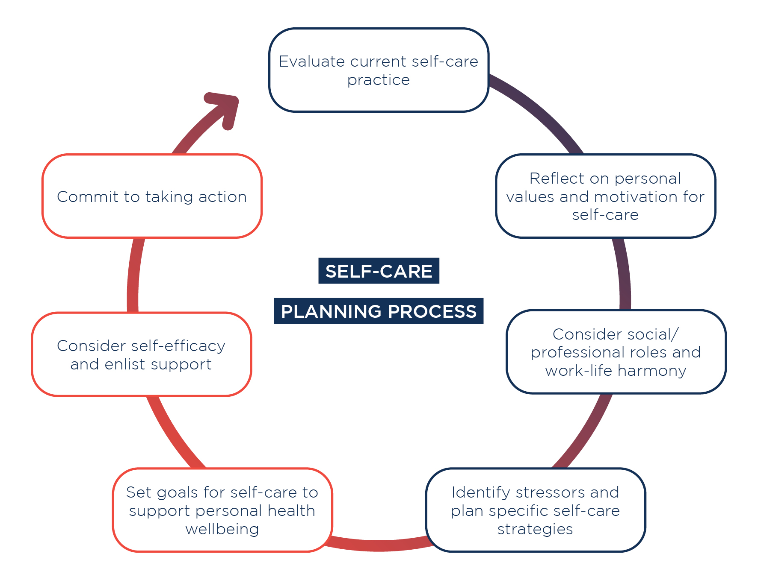
Notes:
We know that the planning process can be difficult, so think about the people in your life, in your network that can give you a break? What resources can I use? What resources are available? Remember, you don’t have to plan a big to do, look for time to do the small things, to take the small breaks. But try to plan it in your schedule, so that you are more likely to complete it. You can even include your family members in the process. When you check out some of the resources we have shared on breathing exercises and yoga. These are things you can do for free and as a family if need be.
If you’re not yet sure about developing a formal self-care plan, you might like simply to reflect on the self-care planning process. This is because the proactive nature of consciously planning for self-care can also be effective, without necessarily documenting a plan on paper. 4
Whichever option you prefer, personalised planning for self-care can be a tremendous support for putting the theory of self-care into practice.Proactively planning your personal strategies for self-care is important. In the words of an Australian palliative care nurse, ‘self-care goes down the toilet when it’s random—there’s no effective random self-care’5
Now that you know more about the importance of and the process of planning for self-care, you might like to develop your own formal self-care plan

Slide 17
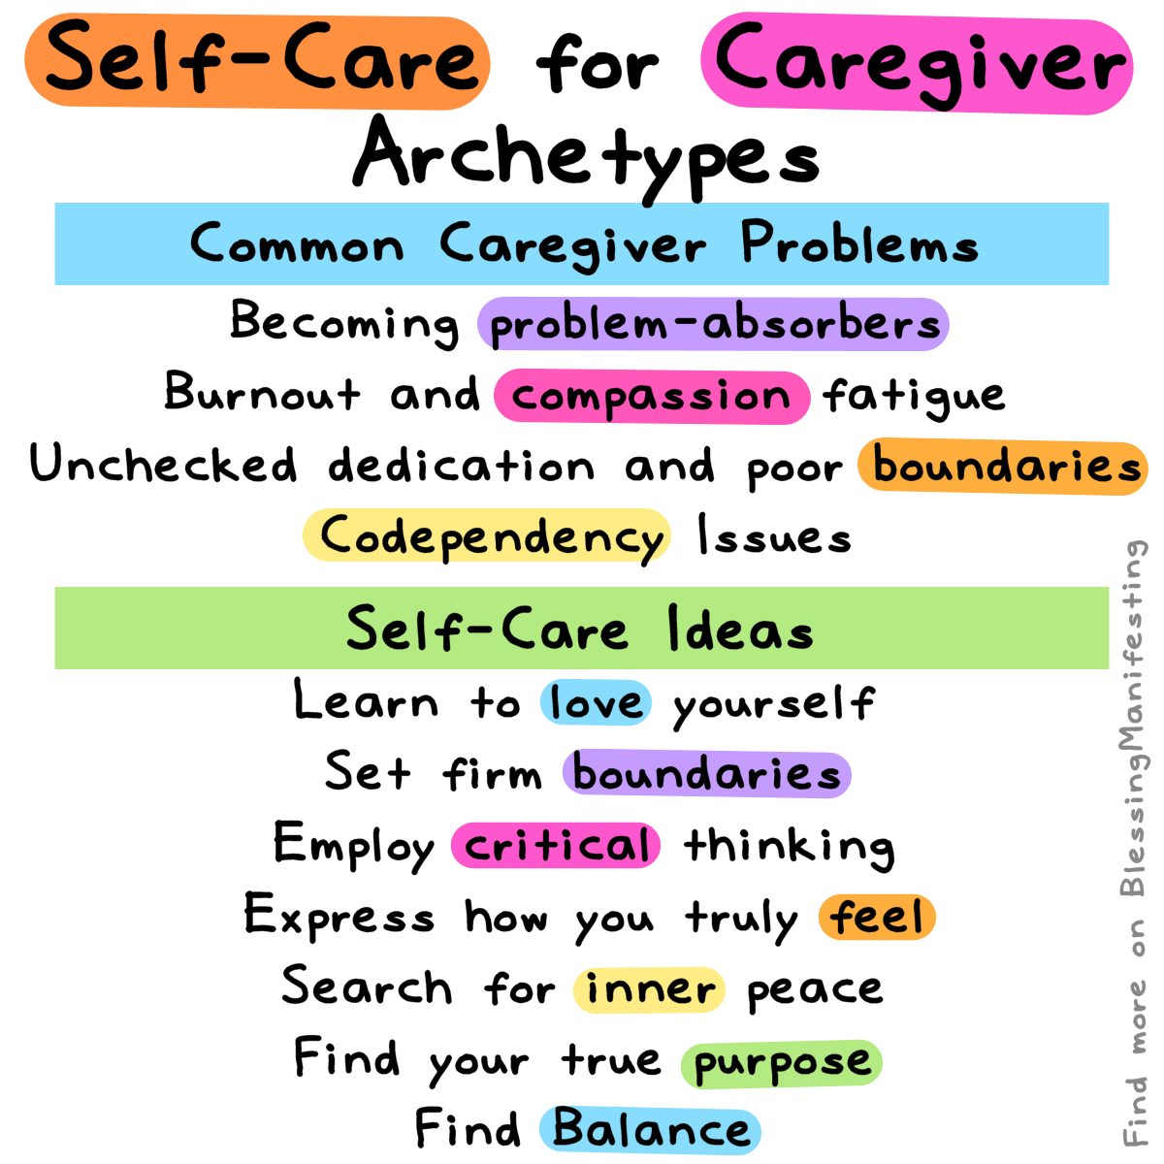
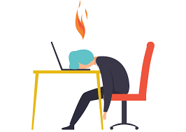


Slide 18
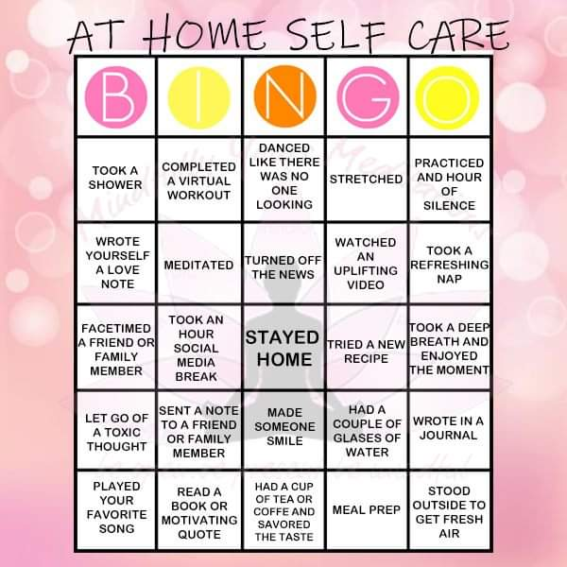
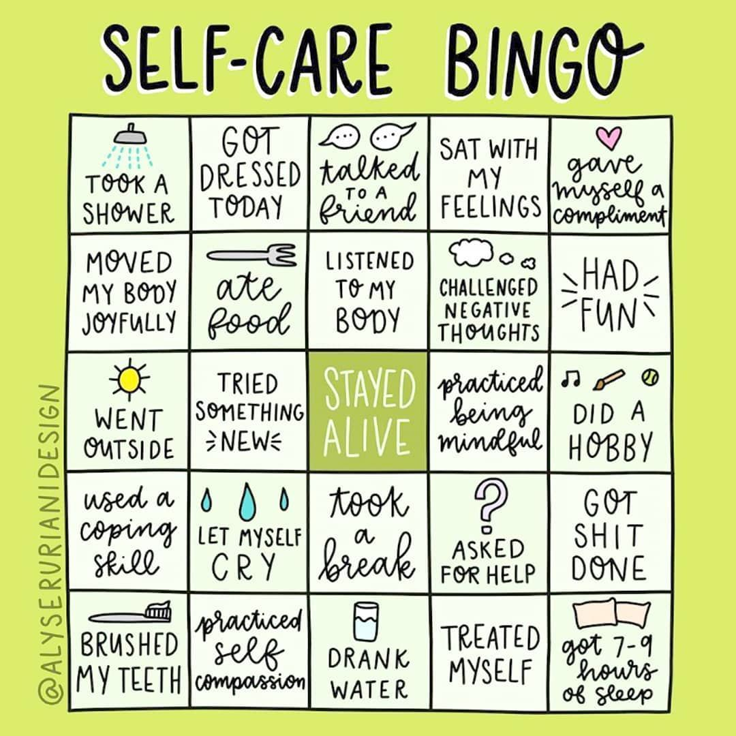
Let’s play a game!
Notes:
Try these printable self-care bingo games with a list of basic self-care ideas. Print it out and try to cross them all in a month or so. Use it like a weekly or daily self-care checklist or as a reminder.
Keep the same self-care routine on the bingo or switch things up a little bit each month!
Check out the blank template so you can create your own bingo.

Slide 19
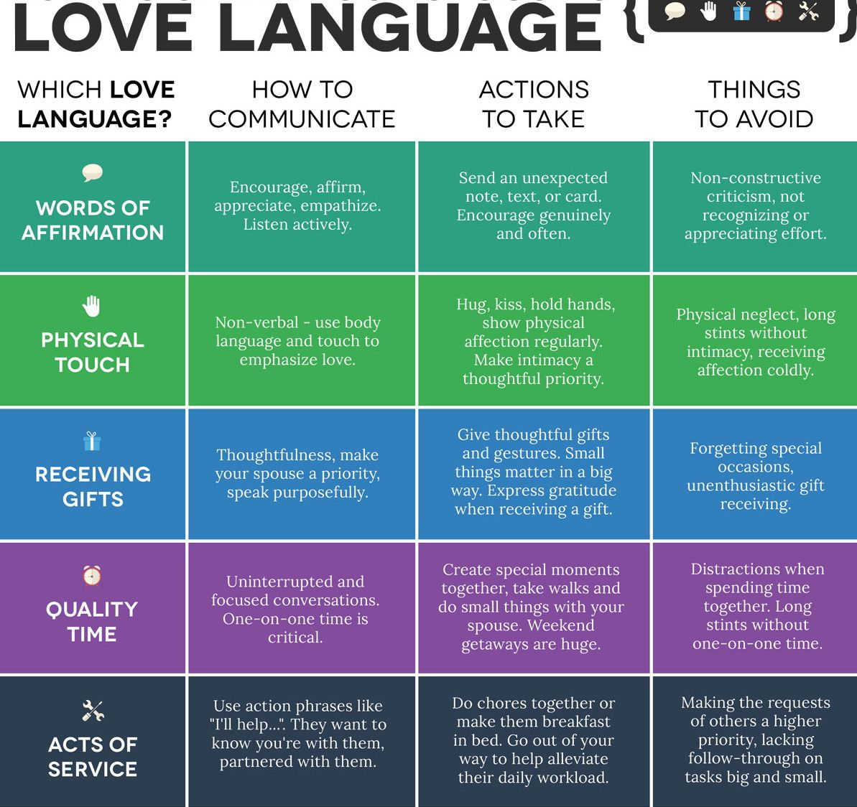
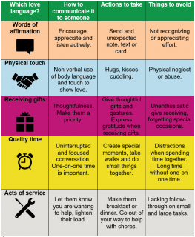
What is your love language?

Slide 20
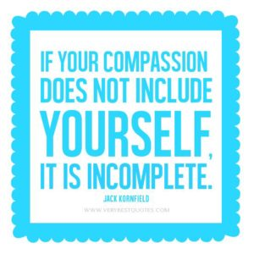
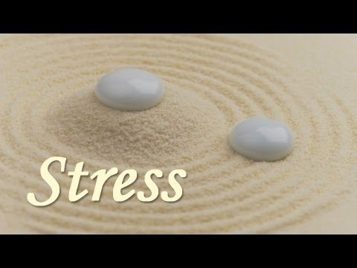
What is Compassion fatigue?
https://www.youtube.com/watch?v=sLLxbTZEh6E

Slide 21
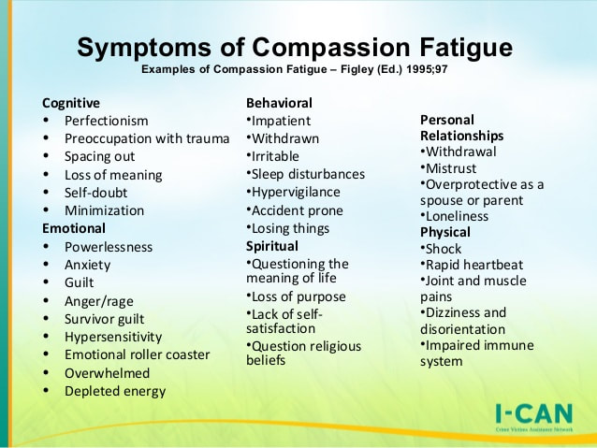
What is Compassion fatigue?

Slide 22
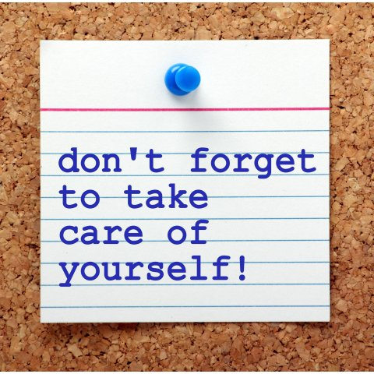
Take aways
Identifying stressors
Self-care strategies
Self-Care Bingo
5 love languages
Compassion fatigue
Notes:
We’ve never gone through anything like this before.
Here’s how we’re going to get through this –
one day at a time, one thing at time, and one moment at a time.
Prioritizing your self-care is a way you can do your part in all of this.

Slide 23

Questions & Feedback

Slide 24
Citations & Resources
How to Support Children's Emotional, Educational Needs while Remote Learning | University of Michigan
Webinar: Autism, Parenting, and Self-Care, Kristin Pleines, LCSW, DSW
Oath to Self-Care and Well-Being – MUKTA PANDA, MD
Self-Care
COVID-19 - The Self-Care Institute
Self Care for Parents | Coronavirus Resources for Families
Self-Care Matters - Palliative Care
Autism Society: Home
Developing a self-care plan | Teacher wellbeingLisa Damour, PhD
Self-Care Exercises and Activities
Our Mindful Life: Home

Slide 25
Citations & Resources Cont’d
5 Love Languages
https://www.5lovelanguages.com/quizzes/
https://www.mindbodygreen.com/articles/the-5-love-languages-explained
http://virtualpublications.soloprinting.com/publication/?i=567736&article_id=3307006&view=articleBrowser

Slide 26
HCAS resources
Howard County Autism Society – Providing Support. Promoting Awareness. Advocating for Change.
Support Groups (Currently all Virtual)
Asperger’s Family Support Group– Designed for family members. Meets the second Thursday of each month at HCAS from 7:30-9:00pm. For information, call 410-290-3466.
Latino Parent Support Group – Conducted in Spanish/English, this family support group meets most months at HCAS. Child care provided. Consult the calendar for upcoming dates or call Marianela Estrada at 973-223-1024. Para más información y para inscribirse, contacte a: Marianela Estrada emailnella22@gmail.com; 973-223-1024.
General Support Group – Designed for family members with children of any age with ASD. Led by HCAS’ Family Navigator, Stacy Hurley, these gatherings will have a different focus each month. For more information, check the calendar at howard-autism.orgor call 410-290-3466.
Notes:
We provide respite resources, emergency grants, the family navigator, parent support groups. For these specific resources, please call the HCAS. For support groups and events, you will need to register.

Slide 27
Video Resources
Breathing Exercise:
Diaphragmatic Breathing Technique (laying down)
Yoga Three Part Breath (sitting/ standing)
Progressive Muscle Relaxation
https://www.youtube.com/watch?v=1nZEdqcGVzo (6 minute guided relaxation)
Body Scan Meditation (10 minute guided relaxation)
Ted Talk on Yoga:
Krishna Sudhir: What yoga does to your body and brain
Ted Talk on Drawing:
Shantell Martin: How drawing can set you free | TED Talk

Slide 28
Video resources (cont’d)
Ted Talk on Perfection:
https://www.ted.com/talks/thomas_curran_our_dangerous_obsession_with_
perfectionism_is_getting_worse
Ted Talk on Connections During Quarantine:
Priya Parker: How to create meaningful connections while apart
https://lakikid.com/pages/ask-an-autism-mom-ep-55-preventing-caregiver-burnout
https://www.youtube.com/watch?v=sLLxbTZEh6E

Slide 29
Other resources
Books:
Nataly Kogan, Happier Now
Rick Hanson, Hardwiring Happiness: The New Brain Science of Contentment, Calm, and
Confidence
Lori Gottlieb, Maybe You Should Talk to Someone: A Therapist, HER Therapist, and Our
Lives Revealed
Jen Sincero, You Are a Badass: How to Stop Doubting Your Greatness and Start Living an
Awesome Life

Slide 30
Link to printable resources
Self Care Printable Resources

Slide 31
Contact information
Stacy Hurley, LCSW-C -- Howard County Autism Society
stacy.hurley@howard-autism.org

