Slide 1
Low Intensity Support Services- LISS
Penn-Mar Human Services
310 Old Freeland Road Freeland, MD 21053
877-282-8202 (phone)
410-357-4767 (fax)
liss@penn-mar.org

Slide 2
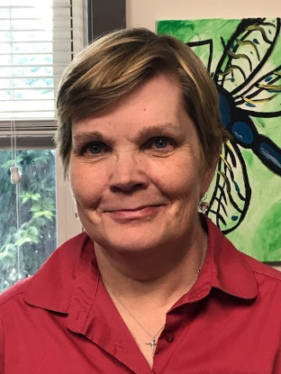
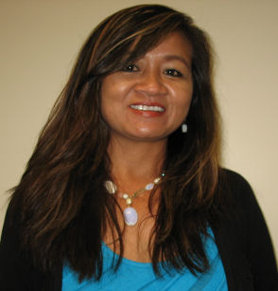
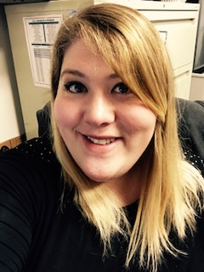
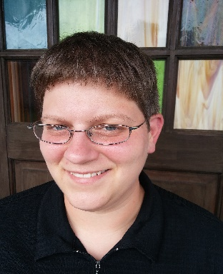
Meet the
Penn-Mar LISS
Staff
Vicky Petrucci- LISS Assistant
Thea Beamesderfer – LISS Coordinator
Maria Hofmann- LISS Assistant Manager
Jes Blais- LISS Manager

Slide 3
What is LISS?
LISS is designed to improve an individual or family’s quality of life, increase or maintain independence, and participate in their communities.
LISS grants eligible applicants up to $2000.00 for identified services and items to support identified needs.
The Developmental Disabilities Administration (DDA) distributes LISS funding twice during each fiscal year (July 1- June 30), in two rounds

Slide 4
How are individuals chosen for funding?
DDA conducts a random selection to choose the applicants who may be eligible for funding.
Being selected does not guarantee approval. Once an applicant is selected the applicant and their requested service need to be determined eligible.

Slide 5
Who is eligible for funding?
In order to be eligible for LISS the applicant must:
  Be a Maryland Resident
  Have a eligible diagnosis
    An eligible individual is defined as:
    An individual who is living in the home or the community and has a severe chronic disability that is attributable to a physical or mental impairment, other than the sole diagnosis of a mental illness, or to a combination of physical and mental impairments and is likely to continue indefinitely

Slide 6
Who is eligible for funding?
Continued
If the individual is enrolled in a Medicaid Waiver at the time of random selection they are not eligible for LISS services.
Individuals receiving any services through DDA are not eligible for LISS with the exception of CCS ( Coordination of Community Services)
If you are receiving REM (Rare and Expensive Medical) , Model Waiver or Community First Choice (CFC) you are still eligible for LISS funding
Examples of these waivers include:
Brain Injury Waiver | Older Adults Waiver
Autism Waiver | Residential Treatment Waiver
Medical Day Wavier | Community Pathways Waiver
 | Living At Home Waiver

Slide 7
When can I apply?
We are currently accepting application for Fiscal Year 2018
  (July 1, 2017- June 30, 2018)
Applications must be submitted via mail or in person by June 30, 2017
We are accepting random selection applications today

Slide 8
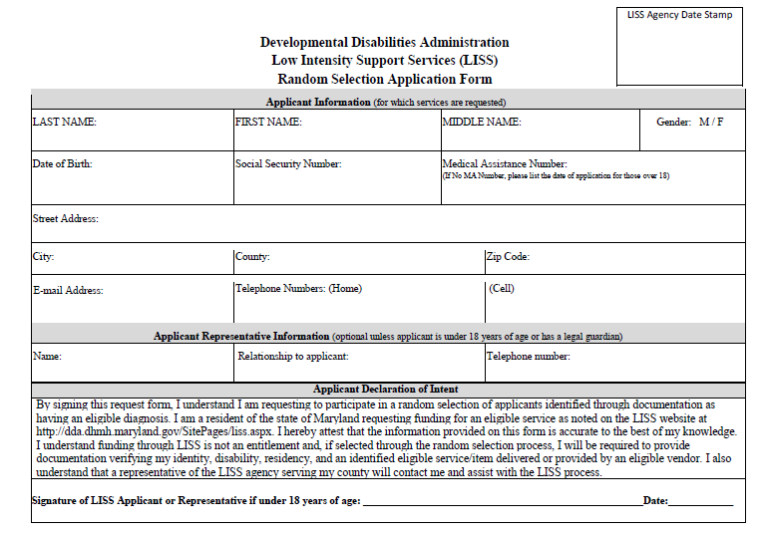

Slide 9
Where can I send my application?
Penn Mar Human Services: 310 Old Freeland Road Freeland, Maryland 21053
  Counties served include Allegany, Anne Arundel, Baltimore City, Baltimore County, Carroll, Frederick, Garrett, Harford, Howard and Washington
United Needs and Abilities: 688 East Main Street Salisbury, Maryland 21804
  Counties served include Caroline, Cecil, Dorchester, Kent, Queen Anne’s, Somerset, Talbot, Wicomico, and Worcester.
Maryland Community Connection: 4401 Nicole Drive Lanham, Maryland 20706
  Counties served include Calvert, Charles, Montgomery, Prince George’s, and St. Mary’s

Slide 10
You will be informed via mail whether you were selected or not selected
*if you are not selected, please submit an random selection application for next round
Random Selection Occurs:
July 15, 2017

Slide 11
Ineligible Services
  All experimental or treatments prohibited by the Health Occupations Licensing Boards and the State and federal entities are excluded services
  Cash
  Case Management
  Gift cards
  Presents, such as birthday or Christmas
  Toys except those recommended for specific therapeutic purposes
  Vacations, even if sponsored by a special needs vendor
  Vehicle related items and services such as gas, tires, registrations, parking tickets, insurance, repairs, vehicle purchases, emissions, and fines.
  Housing assistance

Slide 12
Eligible Services
Adaptive/Specialized Equipment
Assistive Technology
Attendant care/Personal Care
Camp (youth & adult)
  Requires certification by DHMH, OR Accreditation by MSDE (such as a school or childcare), OR American Camping Association Certification, OR approval by DDA or other state entity.
  If therapeutic a letter of recommendation and proof of licensure for the person providing/overseeing the service
Community Integration Services (including Recreation)
Crisis Intervention and Follow up
Daycare (adult) or Childcare (Child)
  Requires License/Certification

Slide 13
Eligible Services Continued..
Employment-related services
Housing Adaptations
  Requires proof of home ownership and licensure by the Dept. of Labor
Identification services
Respite
Training and support for self-advocacy
Transportation assistance
Tuition for post secondary academic and vocational services
Tutoring for post secondary academic and vocational services
Other services to maximize independence, productivity, and integration within the community

Slide 14
Eligible Services Continued..
Health services
Dietician and Nutritionist services
Individual and Family Counseling
Medical equipment purchase, rental, and repair
Therapeutic Services
The Services listed above require the following documentation
  Required Documents
    Require a letter of recommendation
    Proof of insurance coverage (Denial letter, EOB, Coverage Summary)
      Choosing to use an out of network provider may not allow LISS to cover the service
    Service must be provided by a Maryland Licensed Professional
      Exception to the licensing requirement is:
        Music Therapy- Certification by the American Music Therapy Association

Slide 15
Documentation
(You will send this information in after you are selected)
Proof of Disability
Proof of Maryland Residency
Proof of Identity
* We need this information each time you are selected *

Slide 16
Proof of Disability please submit at least one of the following:
A letter or evaluation from a licensed professional, on Business letterhead, identifying disability
An APPROVED IEP/or a draft IEP with the previous year’s approved IEP. (The entire IEP is not required. However, if the diagnosis is non-specific in nature i.e. “other health impairments,” and “Developmental delay” etc. the entire IEP and other documented proof of applicant’s diagnosis is required)
A DHMH letter identifying the determination of developmental disability or ‘Supports Only’ status

Slide 17
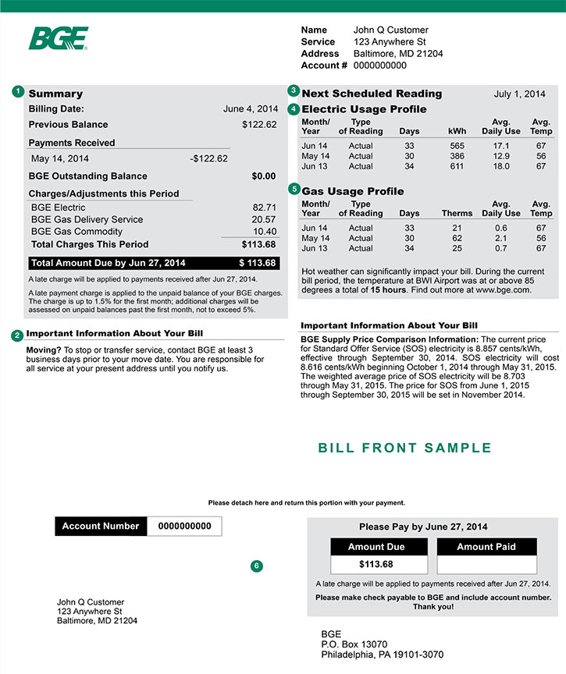
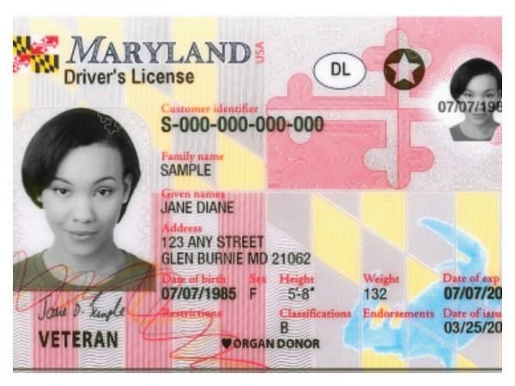
Proof of Maryland Residency
The following documentation, dated within the last 12 months, is acceptable for proof of residence.
A current IEP (demographic page only) or current IP
The following information containing parent’s, is acceptable for applicants under age 18
    A current household utility statement
    Current Drivers License or identification card issued by Maryland
    A current lease agreement
    A current bank or credit card statement
    A mortgage statement or proof of home ownership

Slide 18
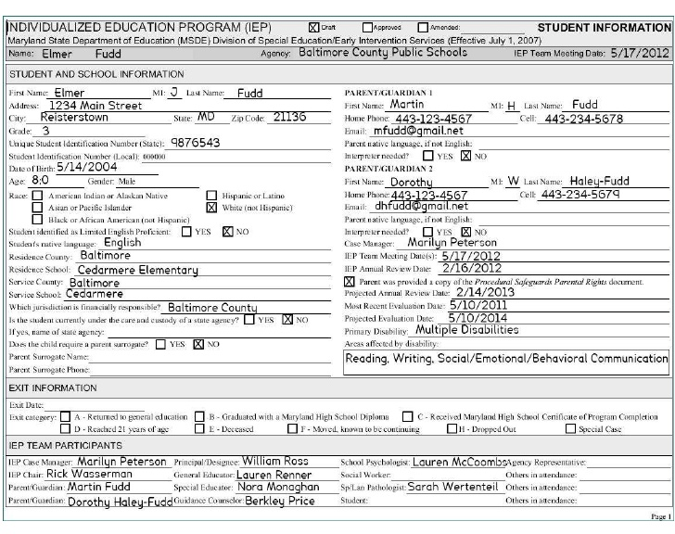
* If your most current address is listed on the Current IEP and so is your child’s disability you can use the IEP as proof of disability and proof of residency
(Autism, Learning Specific)

Slide 19
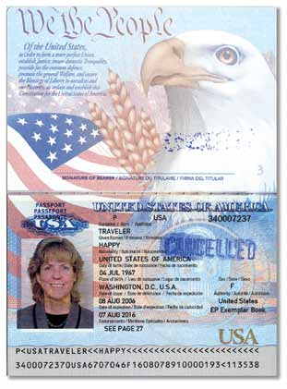

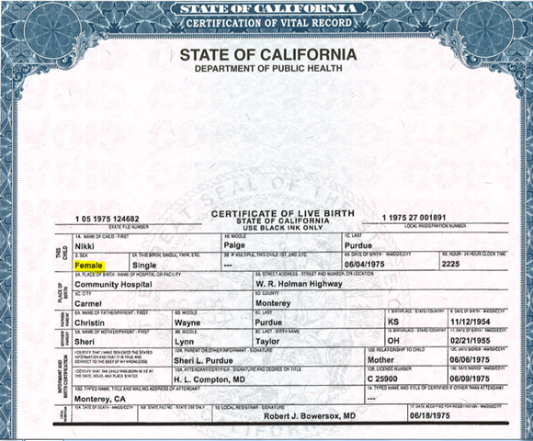
Proof of Identity
Must contain the applicant’s first, middle and last name without the use of initials or nicknames.
A valid social security card issued by the U.S social security administration
A legal birth certificate
A valid passport issued by the U.S Department of State
A current drivers license or identification card issued by Maryland
A valid Military dependent identification card issued by the U.S Department of Defense
A valid Green Card or Student Visa, issued by the U.S Citizenship and Immigration Services

Slide 20
EXAMPLES

Slide 21
If you are thinking of requesting :
Respite
What you will need :
  If you are using an independent contractor:
    you will need W-9 for each independent contractor you are using for the respite
    You will need to set a rate of pay- hourly or daily
  If you are getting the respite through a agency:
    You will need a W-9 from the agency
    invoice showing dates of service, name of individual, and cost.

Slide 22
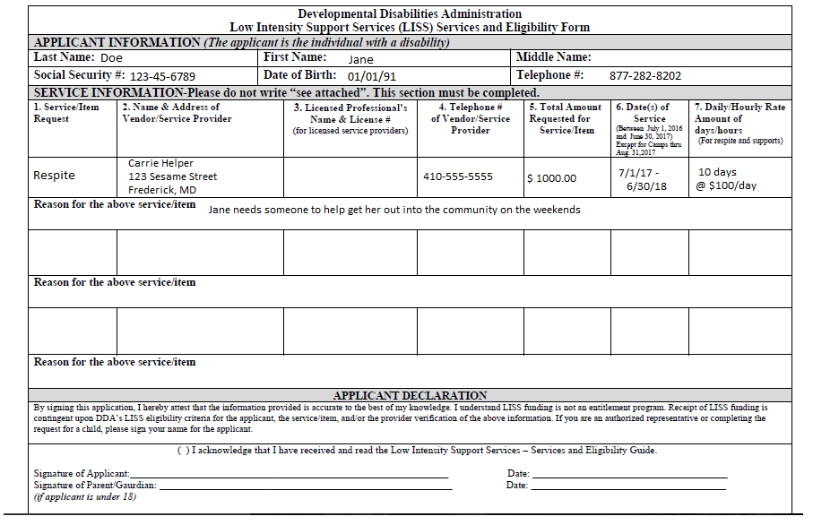

Slide 23
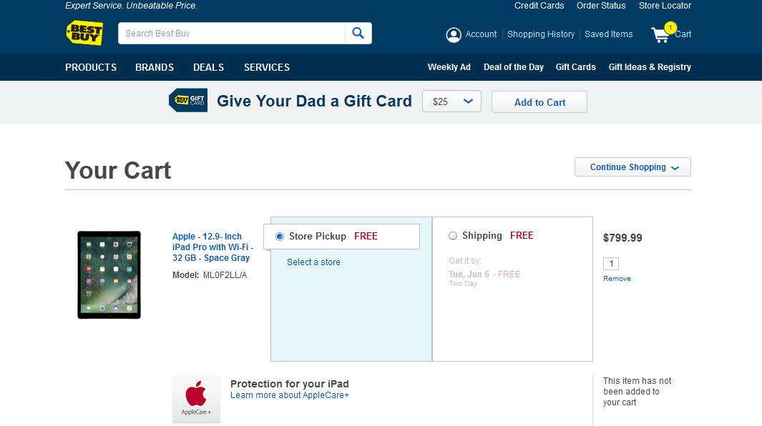
If you are thinking of requesting :
Assistive Technology
What you will need :
  Online shopping cart that shows all requested items including shipping and taxes

Slide 24
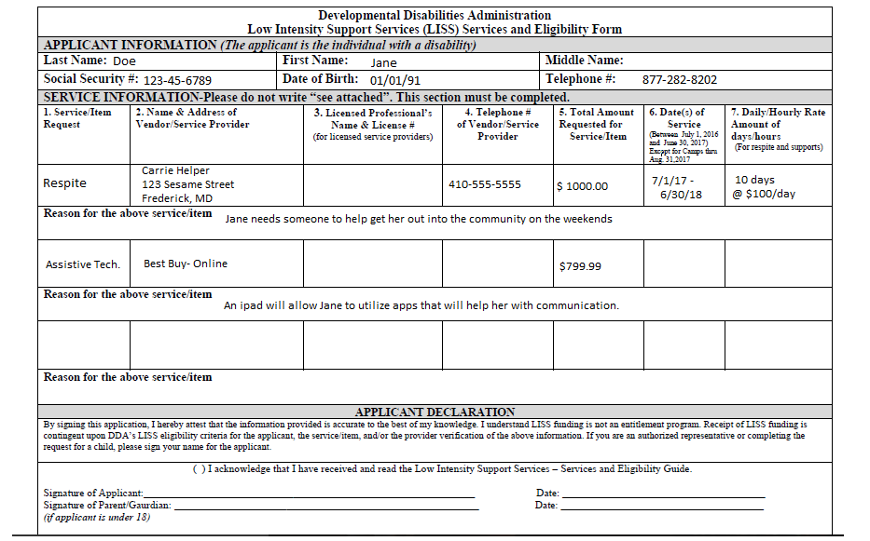

Slide 25
If you are thinking of requesting :
Recreational Services- Swim Lessons
What you will need :
  A W-9 from the vendor of your choosing
  An invoice that includes individuals name, dates of service, and cost.

Slide 26
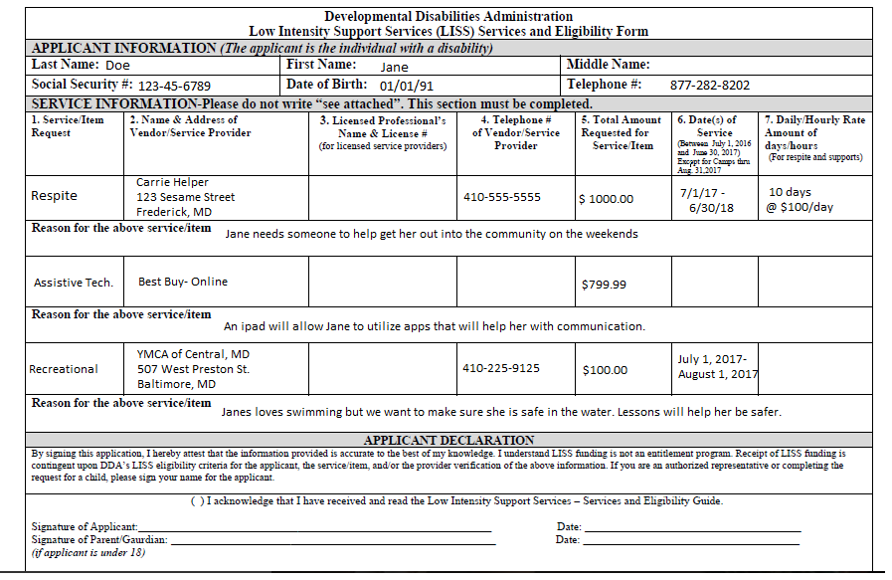

Slide 27
If you are thinking of requesting :
Medical Bill and Co-Pay
What you will need :
  Insurance coverage/non-coverage or explanation of benefits
  Invoice showing dates of service, name and cost
  Letter of recommendation for the services
  W-9 for the company
  If you are seeking reimbursement
    You will need to provide proof of payment (canceled checks, credit card or bank statements)
    An invoice that supports when the services were rendered to the individual.

Slide 28
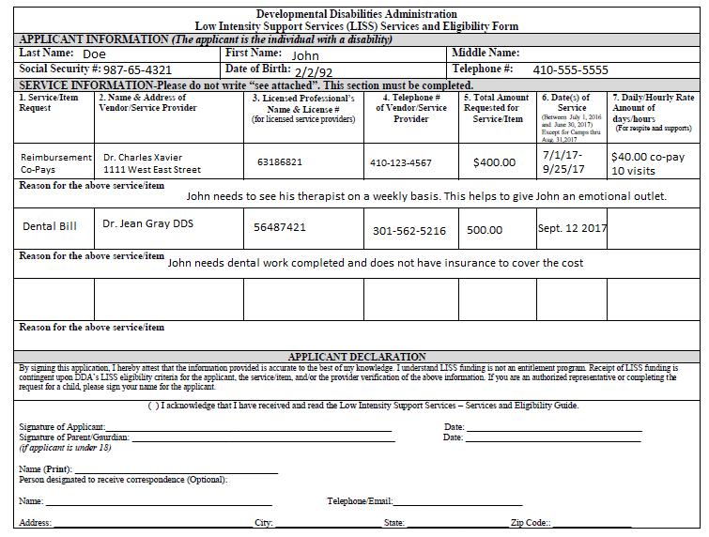

Slide 29
Documentation Continued
Proof of cost for requested service
  Current invoice, quote, letter, or estimate for services
  Includes type of service being provided
  Must have dates of service(s)
    Services must be provided in the same fiscal year as application (July 1 – June 30)
For items procured online:
  Print off of a shopping cart with item(s) requested and total cost (including taxes and shipping)
    Not using a vendor which requires membership (such as Costco, BJ’s, etc)
Any additional documentation which is required based on the service requested such as a letter of recommendation or insurance coverage information

Slide 30
How services/items are paid
Items
  If item is to be purchased through a company, the company will be paid based on the invoice provided
  If item is to be purchased online, the LISS agency will purchase the item online and have it shipped directly to the individual
Services
  Service Providers (company or agency) is paid based on customary practices (how you would pay them for the service)
  Unless reimbursement is requested, the service provider will be paid directly by the LISS agency
  The service provider is responsible for keeping records on the services provided and providing these records to the LISS agency

Slide 31
Questions?
Comments?

Slide 32


Thank you

